Slide 1
DevOpsing in a Microsoft World

Slide 2
DevOps Challenges
Normal, rational hesitation
Functional silos, organizational alignment
Typical ALDO challenges
Monolithic tools, screenshots, click next
Closed source, undocumented APIs, friction
Reliance on vendors for engineering
COTS (Buy vs. Build)
Long tenured staff
Virtualization Complacency
Typical Linux
Org
Typical Microsoft
Org
Columbia
Notes:
Excited because ChatOps is transformative.

Slide 3
Core Challenge: DevOps transformation requires a learning organization

Slide 4
Options
Build a learning organization
Hire DevOps engineers
DevOps initiative
Small batch DevOps to cultivate learning org
Notes:
Excited because ChatOps is transformative.

Slide 5
SWOT Analysis
Strengths Exceptionally tight knit teams Substantial expertise in virtualization, storage Strong operational background | Weaknesses Single threaded in a number of technologies Reliance on vendors (COTS, Microsoft, EMC) Substantial legacy footprint Large population of long-lived pets Organization not “product” oriented Decentralized Internal Customer base
Opportunities “Trying new things since 1938” Centralized Infrastructure Engineering teams Learning Organization / Generative Culture Engineering orientation | Threats Scripting / automation
Notes:
Excited because ChatOps is transformative.

Slide 6
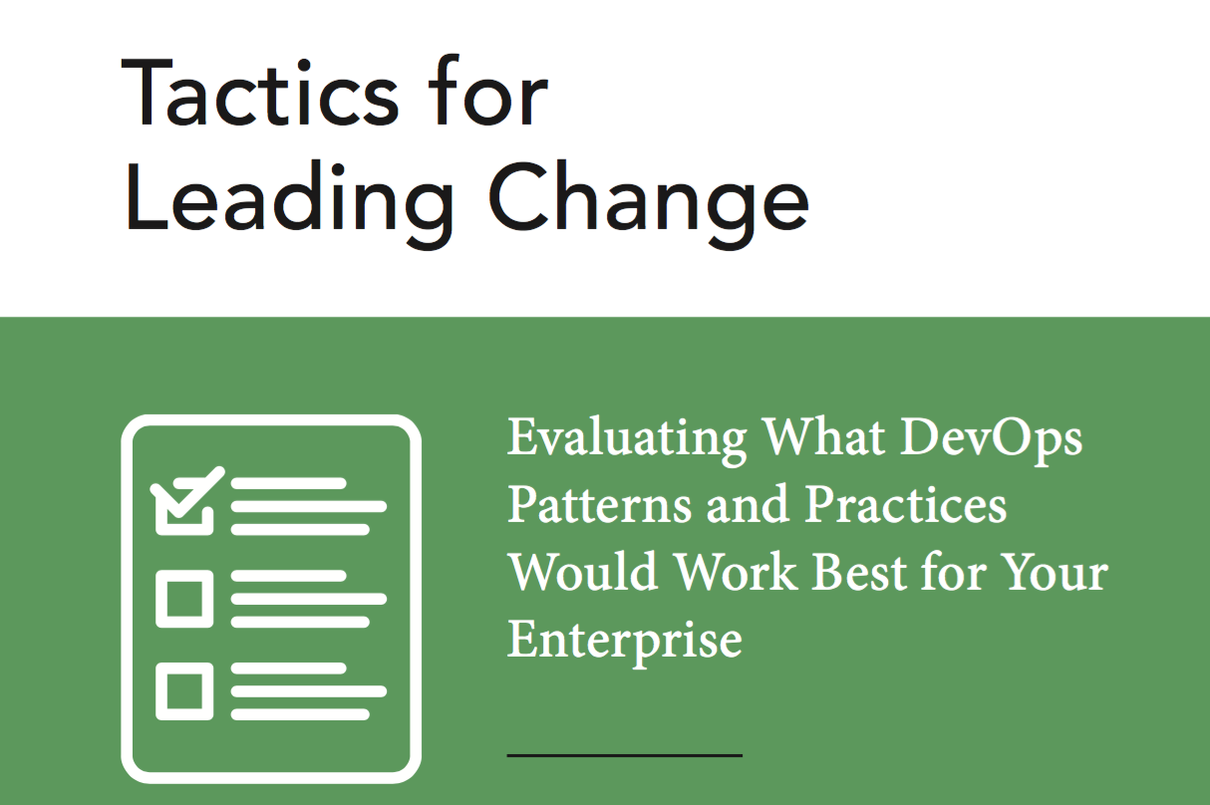
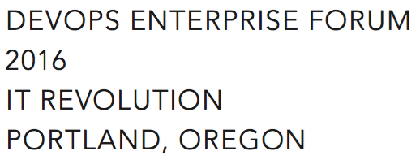
Small batch DevOps
Make a compelling case for change (Tactic 14)
DevOps information sessions (Tactic 2)
Make Work Visible (Tactic 11)
Experiments (Tactic 4)
Gemba Walks (Tactic 9)
Later
Set WIP Limits (Tactic 13)
Blameless Retrospectives (Tactic 5)
Notes:
Excited because ChatOps is transformative.

